Slide 1


Data-Driven Optimization for Inventory, Credit Risk, and Supply Chain Management in New-A-One & Co.
BDM Capstone Project [Jan 2025]
by Aqdas Khan
Roll No: 23f2001156

Slide 2
The Business and The Problems
New A-One Bangles & Co. operates in Firozabad as a B2B wholesale bangle distributor founded by Mr. Izhar Khan. Despite its established presence in the market, the business faces several operational challenges that impact profitability and growth.
The primary issues identified include significant inventory mismatches between recorded and actual stock levels, substantial payment delays and inefficiencies in the supplier network affecting product availability and quality.
These problems represent critical areas where data-driven decision making can create immediate business value and establish sustainable operational improvements.
Inventory Mismatches
Payment Delays
Supplier Inefficiencies
Discrepancies between recorded inventory and actual stock leading to stockouts or excess inventory.
₹2.56 lakhs in overdue payments affecting cash flow and operational capacity.
Inconsistent quality, delivery delays, and pricing issues across the supplier network.

Slide 3




Data Collection and Preprocessing
The foundation of my analysis relied on extracting valuable information from traditional record keeping systems. Primary data was collected from handwritten ledgers maintained by the business, covering a seven-month period from June to December 2024.
These records contained detailed information on sales transactions, purchase orders, and payment histories. To ensure accuracy, all data points were verified with the store owner, Mr. Izhar Khan, who provided additional context and clarification on business operations.
The data was then manually transcribed into Excel spreadsheets, creating a structured digital dataset that could be analyzed using modern analytical tools and techniques.
Source Identification
Located relevant handwritten ledgers containing business transactions
Verification
Confirmed data accuracy with store owner Mr. Izhar Khan
Digital Conversion
Manually entered records into Excel for structured analysis
Preparation
Organized data for analysis across multiple dimensions

Slide 4




Analysis Methods
The analytical approach combined multiple tools and techniques to extract meaningful insights from the collected data. I utilized Excel for initial data organization, Python for advanced statistical analysis, visualization of complex patterns.
For inventory optimization, implemented ABC Analysis to categorize products based on their contribution to overall sales.
Customer payment behavior was analyzed through credit scoring and K-Means clustering to identify distinct risk profiles. Sales forecasting leveraged ARIMA models to predict future demand patterns.
Supplier performance was evaluated using a comprehensive scorecard system and visualized through plots to identify optimal partners based on quality, cost, and reliability metrics.
ABC Analysis
Credit Scoring & Clustering
ARIMA Forecasting
Supplier Evaluation
Categorized inventory items based on sales volume and value contribution
Identified customer payment patterns using K-Means algorithm
Predicted future sales trends based on historical patterns
Created scorecards to assess supplier performance across key metrics

Slide 5
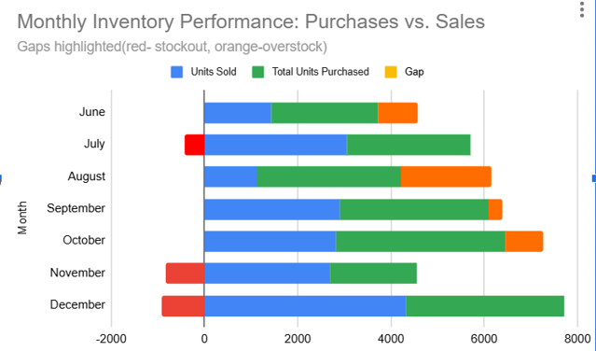
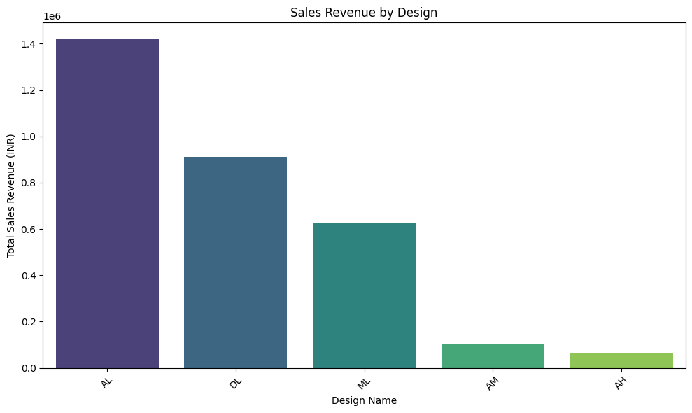
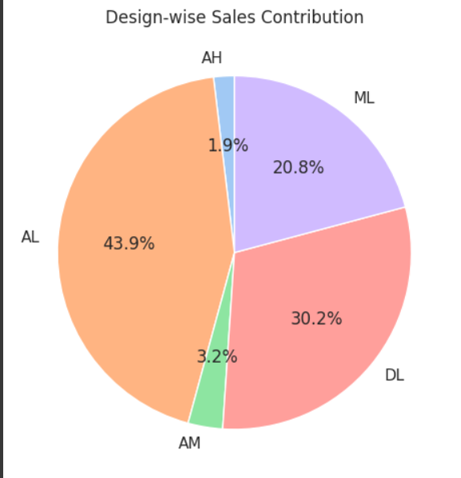
Inventory Analysis Results
The inventory analysis revealed critical insights into product performance and stock management challenges. The ABC classification identified key product categories that drive business revenue, while highlighting discrepancies between inventory records and actual stock levels.
The analysis showed that certain high demand products frequently experienced stockouts despite their significant contribution to overall sales. This pattern indicated a need for more strategic inventory planning, especially for top-performing product lines during peak seasonal periods.
The data also revealed opportunities for reducing capital tied up in slow-moving inventory, allowing for more efficient resource allocation across the product portfolio.
[

Slide 6



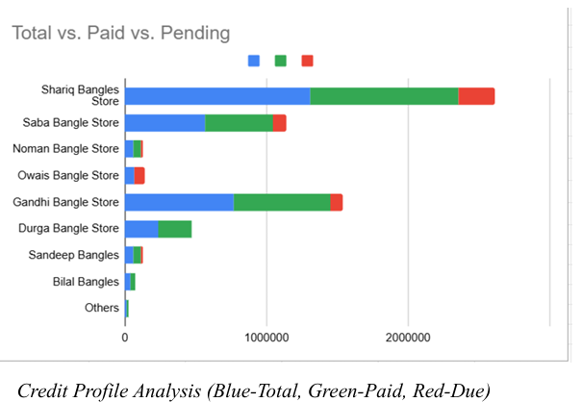
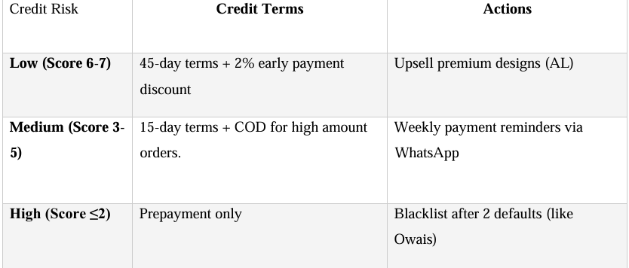
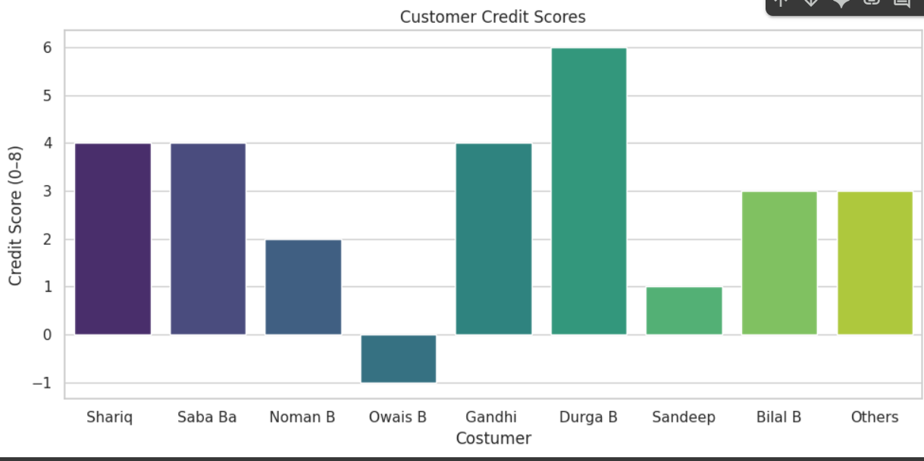



Credit Risk Assessment
Overdue Analysis
Customer Clustering
Payment Patterns
Total overdue amount of ₹2.56 lakhs represents substantial portion of working capital that could be reinvested in inventory or business development.
80% of the overdue amount is concentrated among just two customers, indicating a need for targeted credit management strategies.
Analysis identified correlations between purchase patterns and payment behavior, providing valuable insights for future credit decisions.
Tier 1 Customers(6-7)
Prompt payment, high volume
Tier 2 Customers(3-5)
Occasional delays, moderate volume
Tier 3 Customers(0-2)
Significant delays, requires monitoring
By implementing a structured credit scoring system, the business can now make more informed decisions about payment terms and credit limits for different customer segments, from Tier 1 (prompt payment) to Restricted (cash-only terms).
Restricted Customers(<0)
Major overdue amounts, cash-only terms

Slide 7
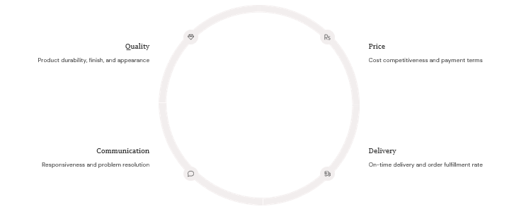
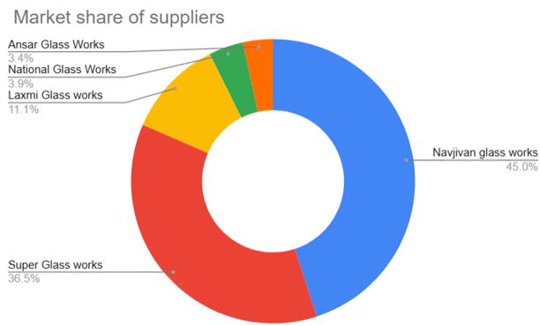
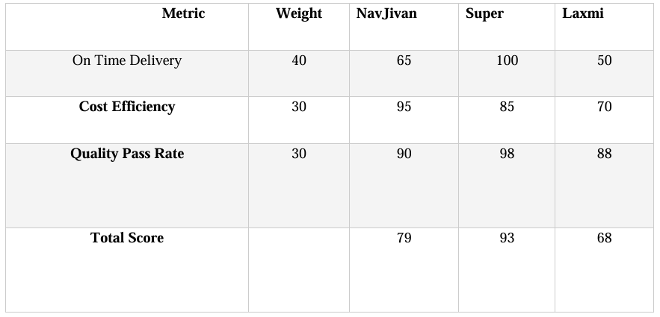
Supplier Performance Evaluation
Super Glass Works
NavJivan
Other Suppliers
Emerged as the top performer, delivering consistently high-quality products with only a slight price premium compared to competitors.
Supplied 45% of total units but had longer delivery times, affecting order fulfillment.
Showed strengths in specific areas but had notable weaknesses that affected overall performance.
Highest volume supplier
Variable quality standards
Highest quality ratings
Inconsistent delivery schedule
Specialized product offerings
Best delivery times
Competitive pricing
Cost inefficiency and late deliveries
Moderate price premium

Slide 8
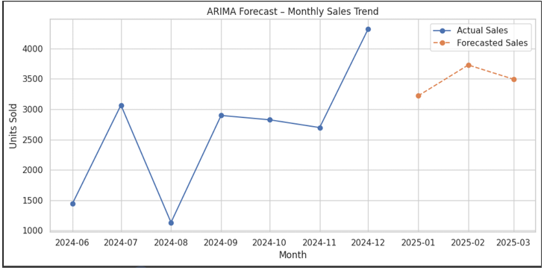
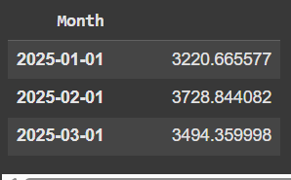




Sales and Forecasting
Pattern Identification
Predictive Modeling
Validation
Strategic Planning
Clear seasonal patterns with significant peaks during October-December festive season when sales volume triples.
ARIMA model provides reliable framework for anticipating inventory needs 3 months in advance.
Forecasting accuracy validated against historical data, showing prediction error of less than 8% for most product categories.
Enables proactive inventory planning to prevent stockouts during peak demand while minimizing excess inventory during slower months.

Slide 9
Key Findings
The comprehensive data analysis revealed several critical insights that directly impact business performance. AL design bangles contribute 44% of total sales but frequently experience stockouts, indicating a significant opportunity cost and potential revenue loss during peak demand periods.
The credit analysis showed that ₹2.56 lakhs in overdue payments is heavily concentrated, with 80% of the amount attributed to just two customers(Shariq and Owais Bangle Store). This concentration represents a significant credit risk that requires immediate attention.
In supplier evaluation, Super Glass Works emerged as the most reliable partner, offering superior quality with only a modest price premium. The sales data also revealed clear seasonal patterns with significant peaks during the October-December festive season.
44%
Rs.2.56L
3x
AL Design Sales
Overdue Payments
Seasonal Increase
Despite frequent stockouts, AL designs contribute nearly half of all sales
80% concentrated among just two customers (Shariq and Owais)
Sales volume triples during October-December festive period

Slide 10

Strategic Assessment: SWOT Analysis
Strengths
Established presence in Firozabad's bangle market
Weaknesses
Manual recordkeeping → delays in analysis
Strong seasonal demand and sales growth (↑120% from June–Dec)
Overstocking of low-demand designs (e.g., ML overstocked by 1950 units)
High-performing designs ( AL = 44% of sales)
And reliable Supplier like Super Glass
Credit risk: ₹2.56L overdue (Shariq, Owais)
Dependency on one major supplier (NavJivan)
Loyal customer base like Durga (100% compliance, credit score of 6)
Opportunities
Threats
Payment delays can affect cash flow and reinvestment
Digitization using Google Sheets/Tally for real-time monitoring
Seasonal reliance → off-season revenue dips
Predictive inventory management using ARIMA forecasts
Supplier delays may cause stockouts during peak demand
Implementing credit scoring system to reduce defaults
Market competition from larger digitized wholesalers
Expand supplier base with performance-based contracts
10
10
10
10

Slide 11




Recommendations
Based on the data analysis, I recommend implementing a strategic inventory management system that prioritizes AL and DL design stock, especially before festive seasons when demand peaks. This approach will minimize stockouts of high-value products and maximize revenue potential during critical sales periods.
For credit management, I advise enforcing stricter payment terms, particularly for high-risk customers like Shariq and Owais. This should include reduced credit limits, shorter payment windows, and potential cash-only requirements for customers with persistent payment issues.
I also recommend diversifying the supplier base while developing incentive programs for timely delivery and quality consistency.
Finally, digitizing business records using affordable solutions like Zoho or Google Sheets POS will improve data accuracy and enable real-time decision making.
Optimize Inventory
Prioritize AL/DL stock before festive seasons to prevent stockouts of high-demand items
Strengthen Credit Management
Implement stricter credit terms for high-risk customers and monitor payment patterns
Enhance Supplier Relations
Diversify supplier base and create incentives for quality and timely delivery
Digitize Operations
Implement affordable digital solutions like Zoho or Google Sheets POS for better tracking

Slide 12
Conclusion & Next Steps
The data analytics initiative has successfully identified key inefficiencies in inventory management, credit control, and supplier relationships at New A-One Bangle & Co. . By addressing these issues with data driven strategies, the business can significantly improve operational performance and financial outcomes.
Moving forward, I recommend implementing a predictive inventory management system that anticipates seasonal demand fluctuations. Monthly credit health monitoring should be established to prevent the accumulation of overdue payments. The business should also begin a phased digital transformation to improve data accuracy and decision-making capabilities.
These steps will not only address immediate operational challenges but also position the business for long-term scalability and sustainable growth in a competitive market.
Implement Predictive Inventory System
Establish Credit Monitoring
Begin Digital Transformation
Deploy data-driven forecasting to optimize stock levels based on seasonal patterns
Create monthly credit health reviews to identify and address payment issues early
Start with basic digital tools and gradually expand capabilities for comprehensive business intelligence

